Slide 1
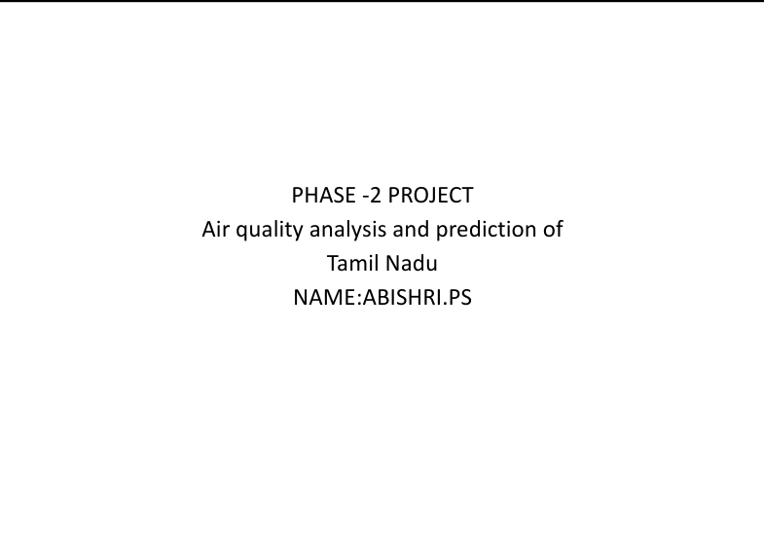
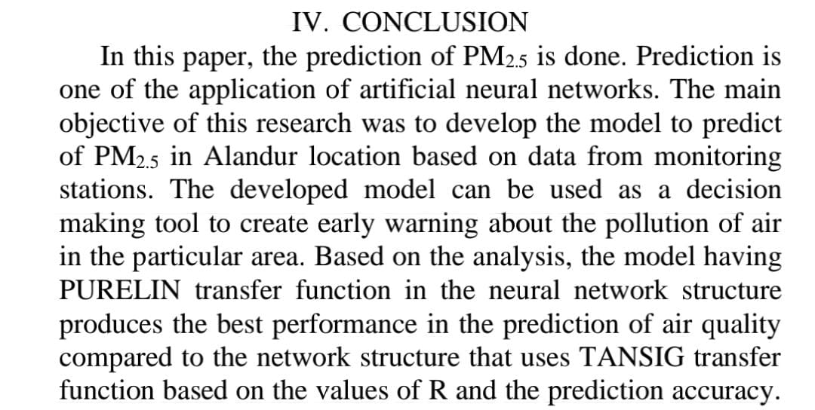

Slide 2
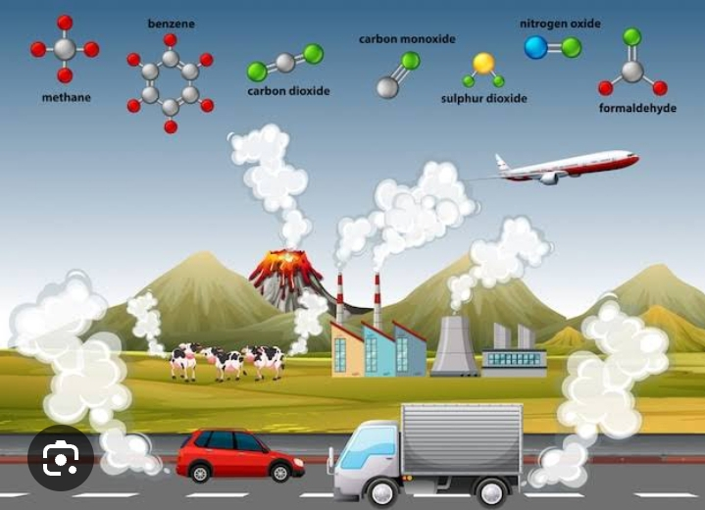

Slide 3
Introduction:
. Tamil Nadu ,a state in South India experience
Varying air quality levels due to industrial,Urban
and natural factors.
.To perform air quality analysis and prediction
several components are involved,Data collection,
Data processing,Air quality index, Analysis and
Modeling,Prediction and forecasting,visualization and reporting,public awareness and policy mitigation.

Slide 4
Linear regression:
a linear regression model is a statistical approach used for modeling the relationship between a dependent variable (also known as the target or outcome) and one or more independent variables (predictors or features). The goal of linear regression is to find a linear relationship that best represents the data, making it a simple but fundamental tool for predictive modeling and understanding relationships within data.

Slide 5
Random forest:
Random Forest is a popular machine learning algorithm that belongs to the ensemble learning category. It is used for both classification and regression tasks.
Gradient boosting:
Gradient boosting is a powerful machine learning technique used for both regression and classification tasks. It builds an ensemble of decision trees in a sequential manner, where each tree corrects the errors of its predecessor. Here's a brief overview of gradient boosting:

Slide 6
XG boosting:
XGBoost, short for "Extreme Gradient Boosting," is a powerful machine learning algorithm that has gained popularity for its effectiveness in various predictive modeling tasks.
Reinforcement learning:
Reinforcement learning (RL) is a subfield of machine learning where agents learn to make decisions by interacting with an environment

Slide 7
Ensemble methods:
Ensemble learning is a machine learning technique that combines the predictions of multiple models to improve overall predictive performance.
Broadly this technique is classified into two
Types namely
Bagging
Boosting.

Slide 8
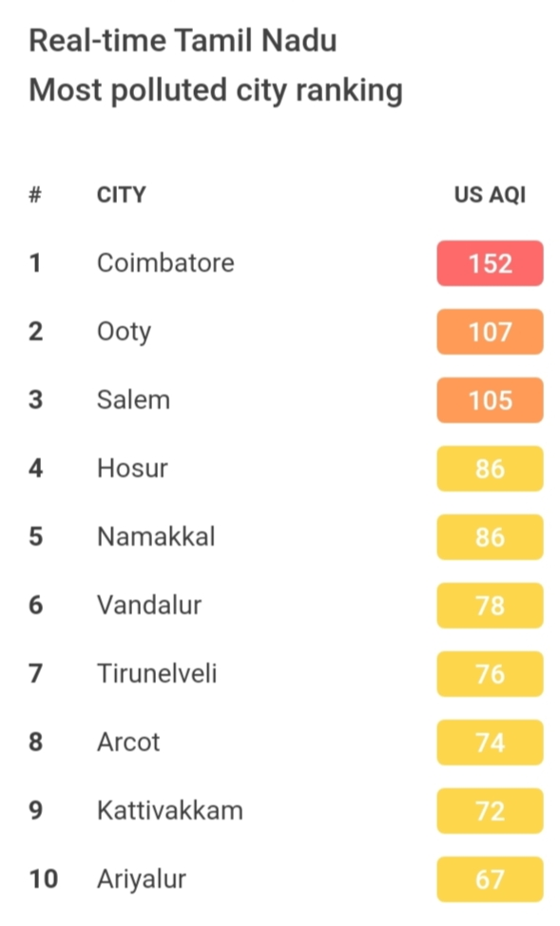

Slide 9
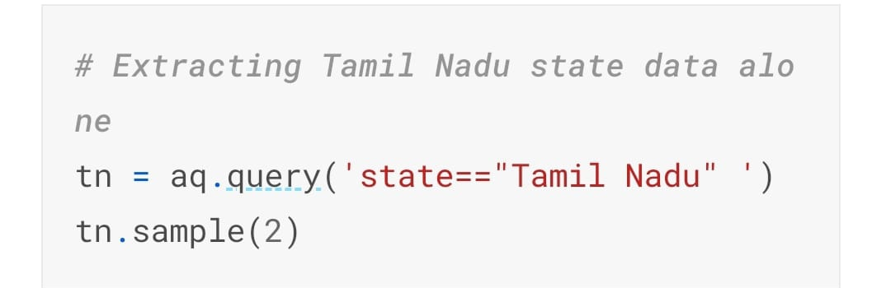

Slide 10
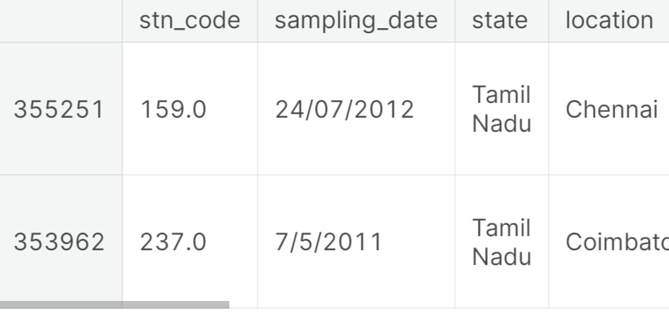

Slide 11
